Slide 1








RESTAURANT
MANAGEMENT SYSTEM

Slide 2




Members:
1.Trần Mai Anh
2. Phan Ngọc Hạnh Nhi

Slide 3
five main features:
Login and Account
Registration
2. Food Management
3. Customer Management
4. Bill Management
5. Revenue Management

Slide 4



LOGIN AND
REGISTRATION

Slide 5
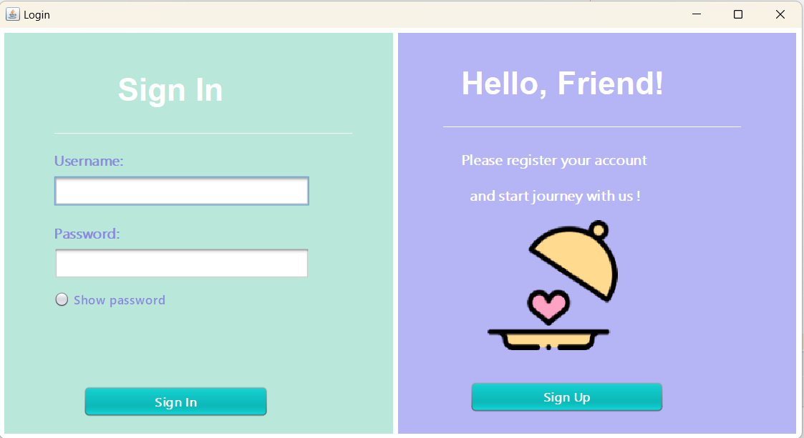

Slide 6
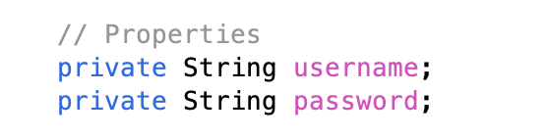
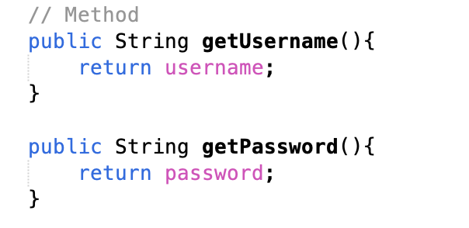
class owner

Slide 7
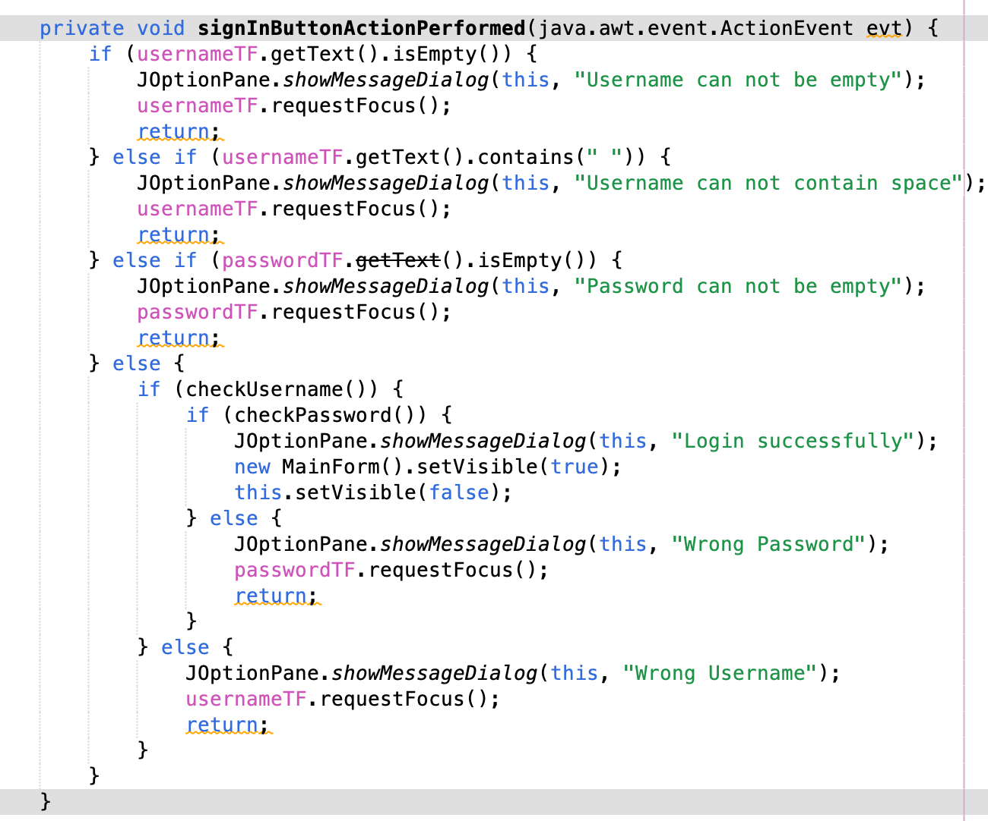
Sign in button

Slide 8
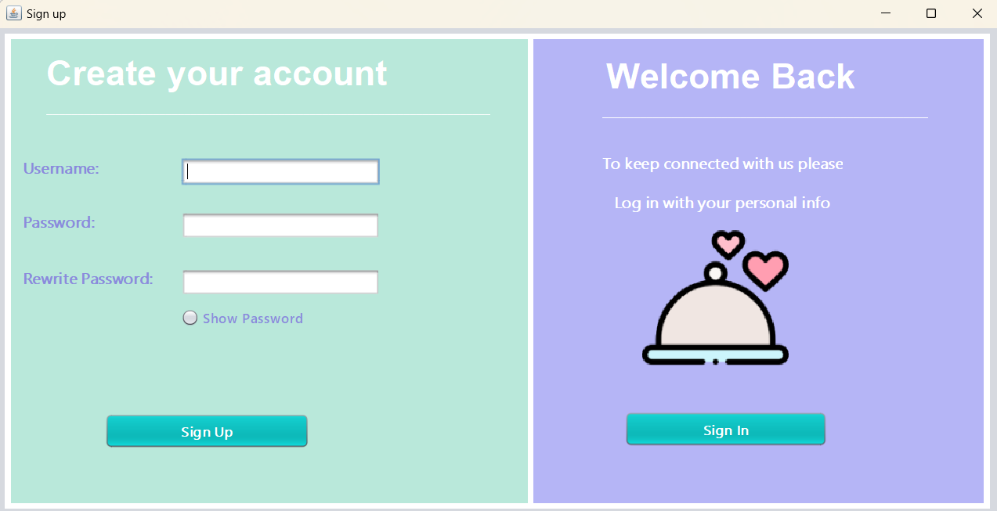

Slide 9
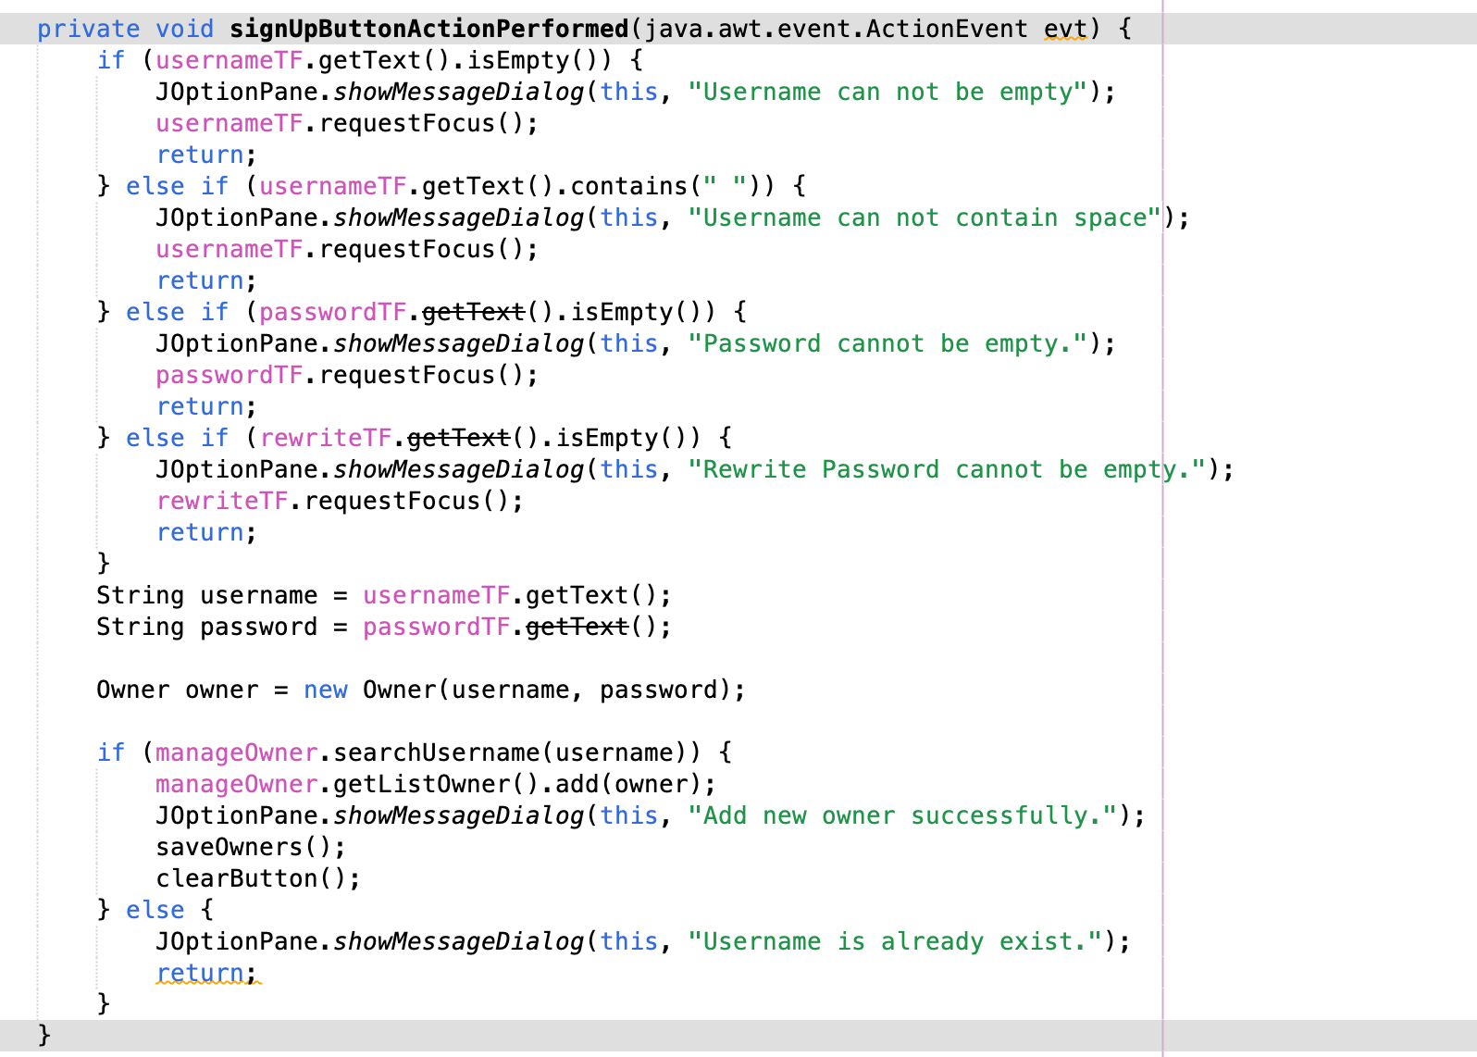
sign up button

Slide 10


food managemnet

Slide 11
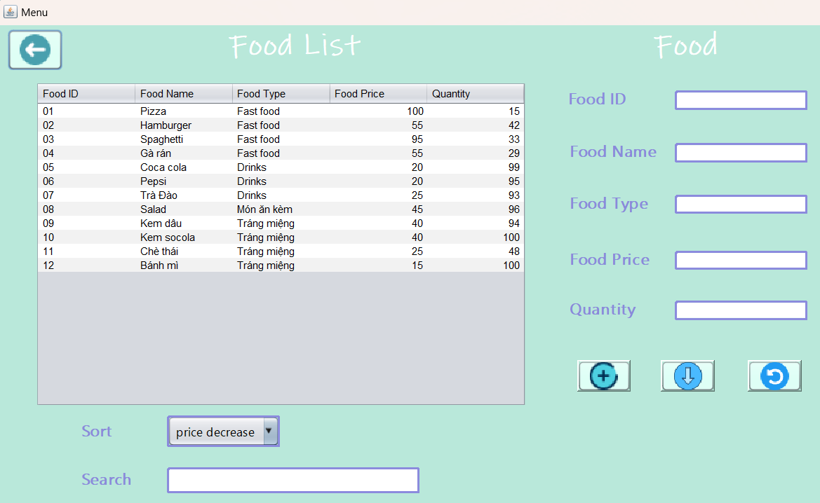

Slide 12
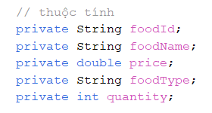
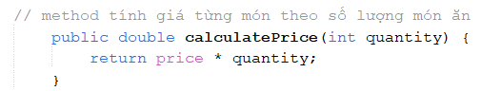
Class food Item

Slide 13
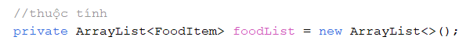
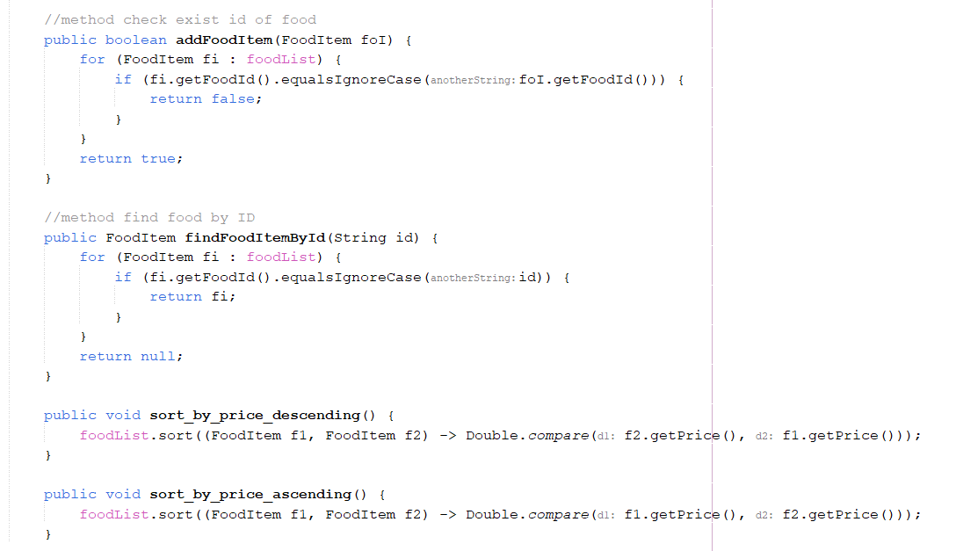
Class food
manager

Slide 14
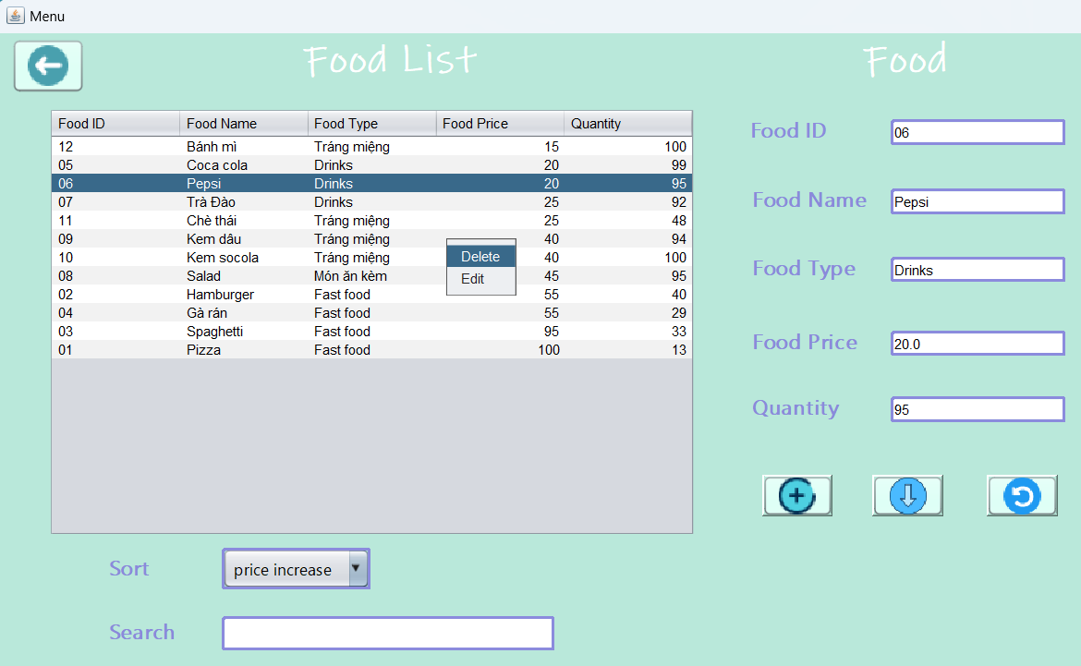

Slide 15


CUSTOMER management

Slide 16
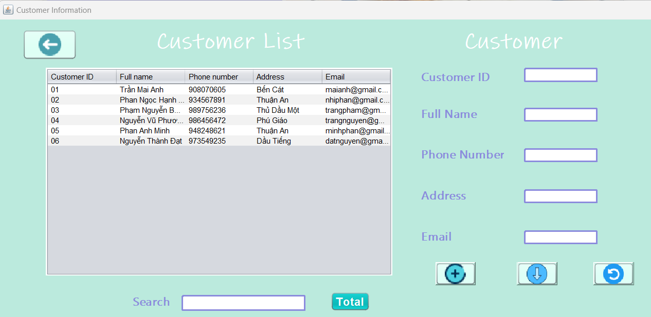

Slide 17
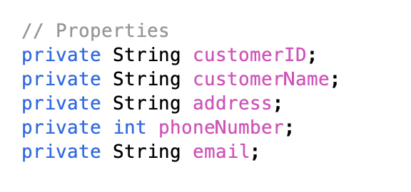
Class customer
// Method: Getter Setter

Slide 18
Class ManageCustomer
// Method:
Getter Setter
AddCustomer
DeleteCustomer
FindCustomer
SearchCustomerByID
SearchCustomerByName

Slide 19
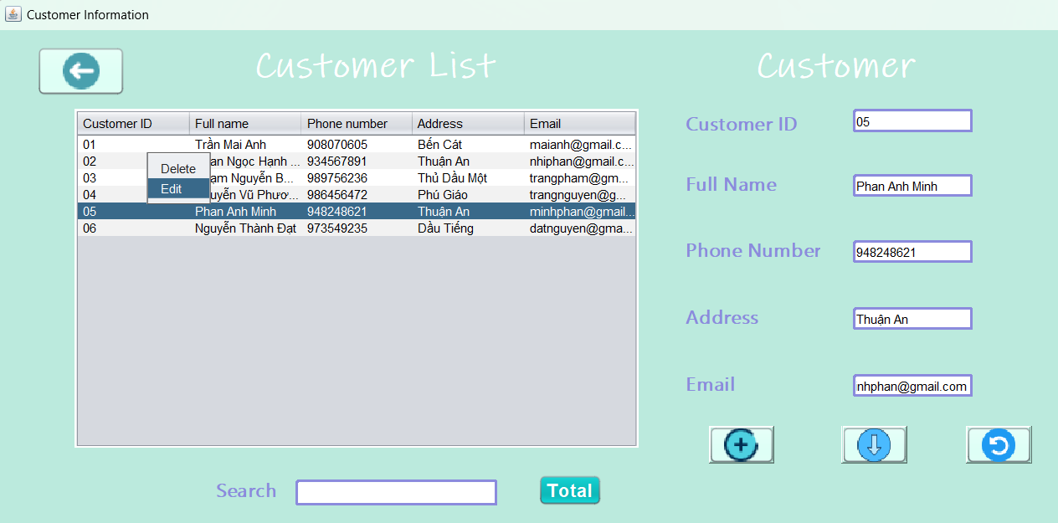

Slide 20



BILL MANAGEMENT

Slide 21
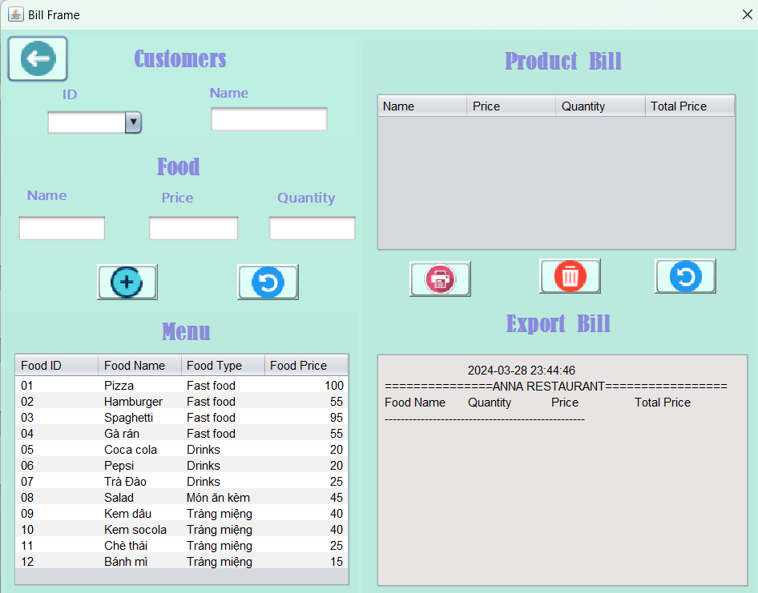

Slide 22
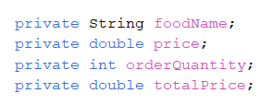
Class food Bill
// Method: Getter Setter

Slide 23
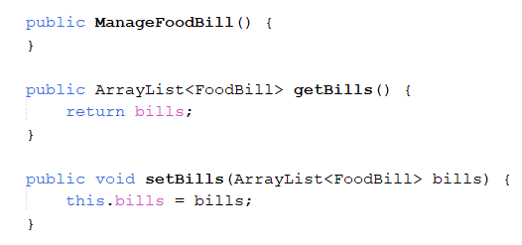
Class Manage foodBill

Slide 24
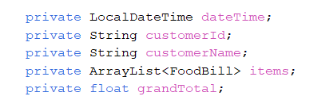
Class MainBill
// Method: Getter Setter

Slide 25

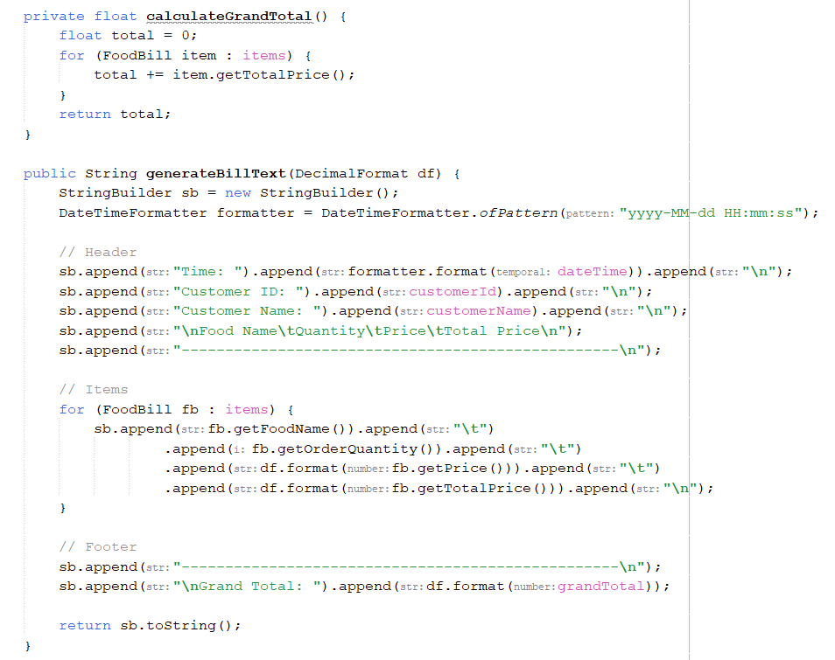

Slide 26
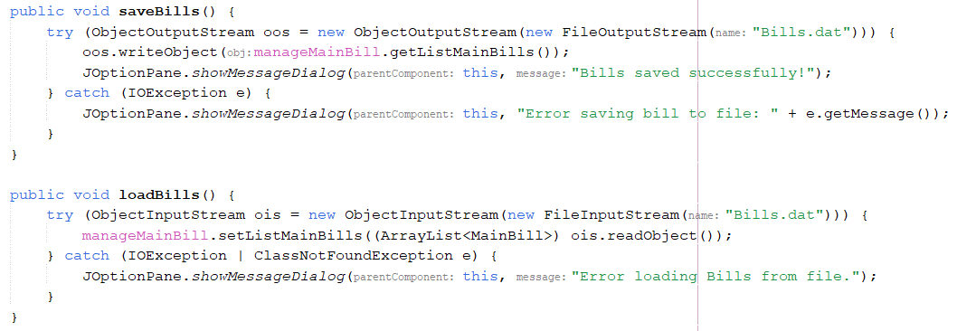
Class manage MainBill

Slide 27
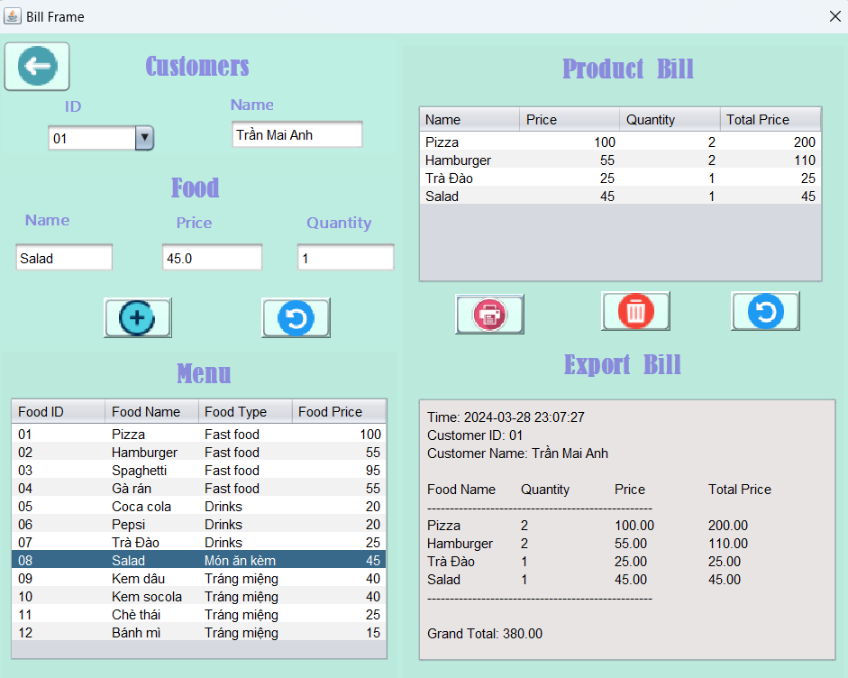

Slide 28



REVENUE MANAGEMENT

Slide 29
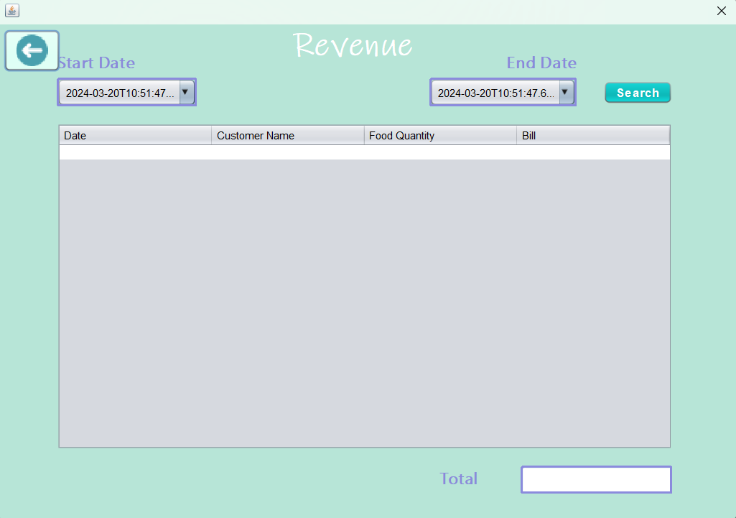

Slide 30
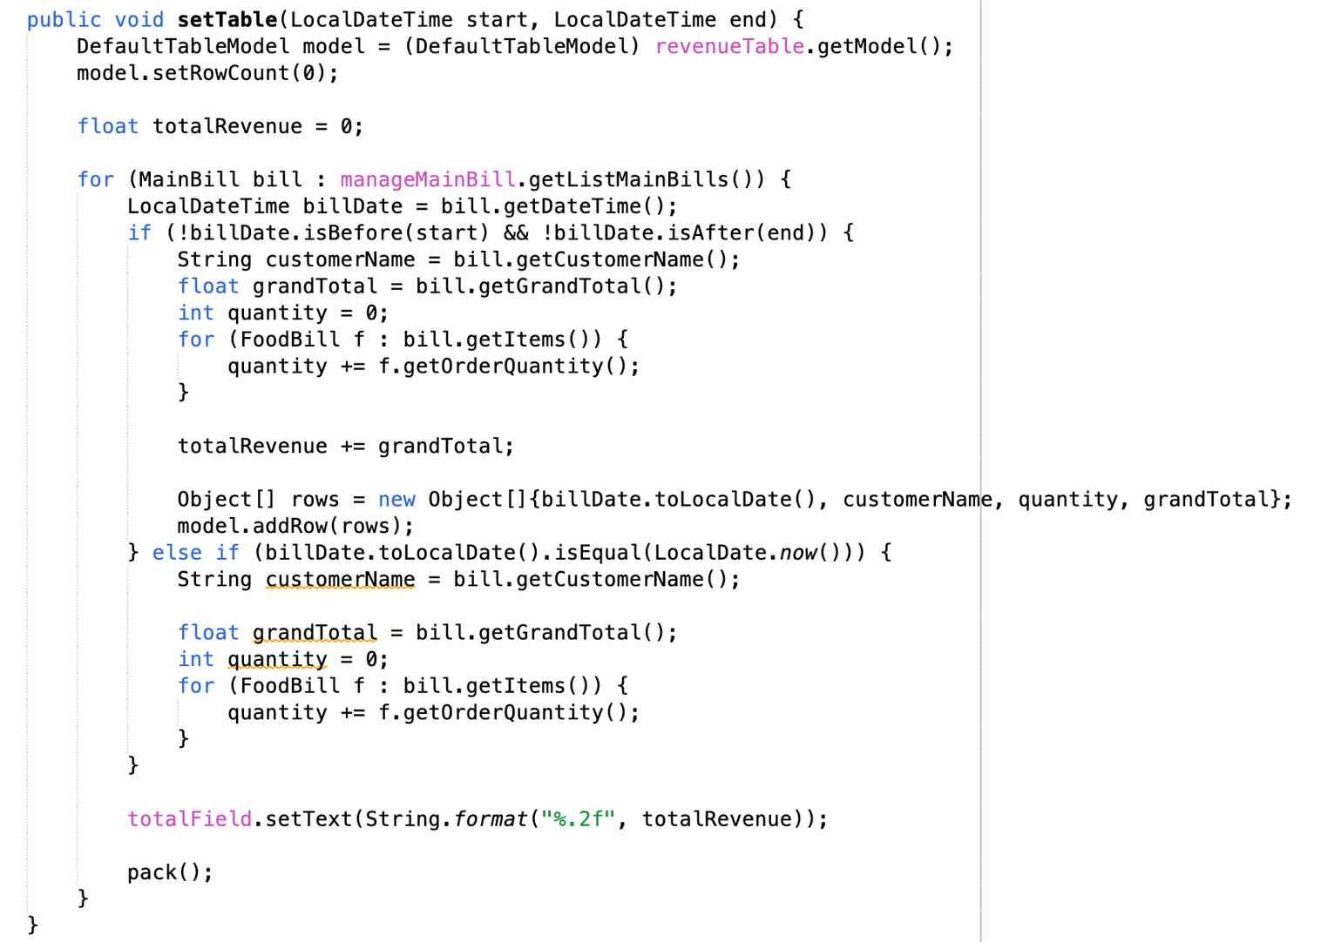

Slide 31
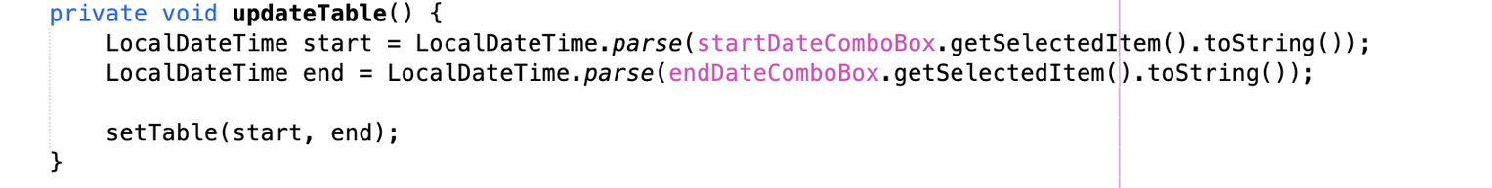
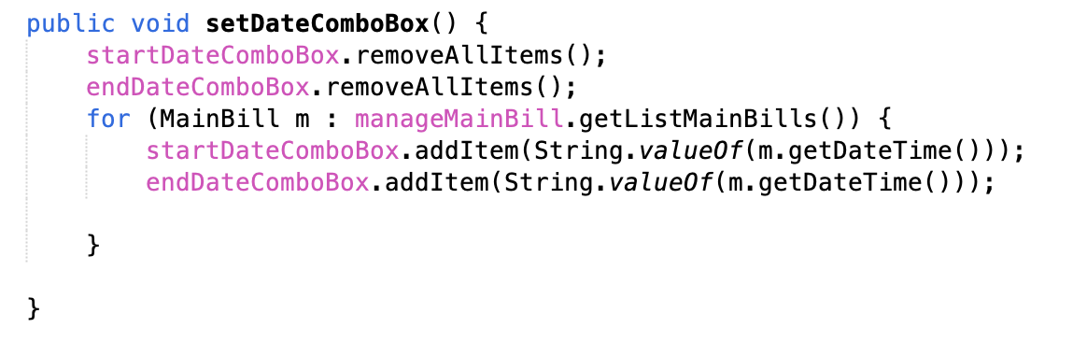

Slide 32
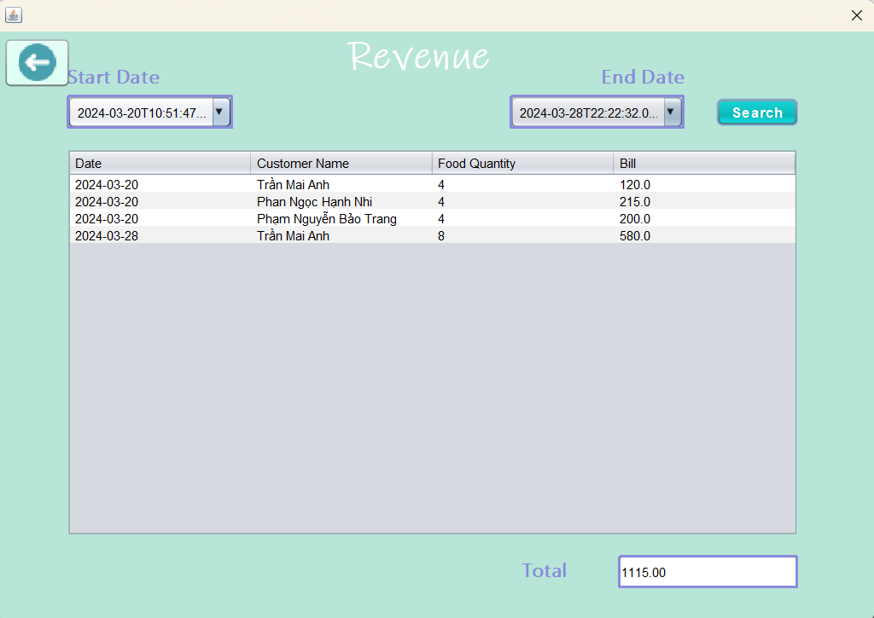

Slide 33

Future Plan

Slide 34

1. AI technology:
Analyze data, predict trends, automate suggestions.
2. Promotion Features:
Create a list of potential customers, from there create a membership card to earn points and an automatic promotion system, updating real-time incentives.
3. External Service Links:
Integrate table booking, delivery, and employee management.

Slide 35
q&A

Slide 36
Thanks for
LISTENING

